Slide 1
Invasive Species Monitoring
W207 Final Project
James, Melwin, Jonah, Stanimir
08/22/2017

Slide 2
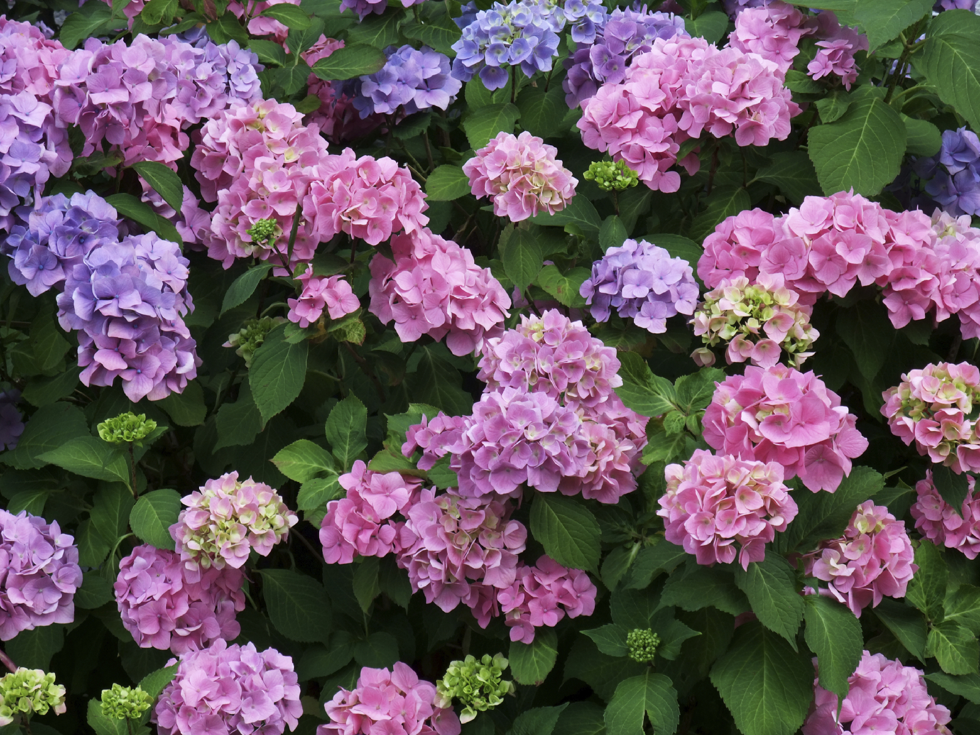
Competition Overview
Tracking the location and spread of invasive species is costly and difficult to undertake at scale
Relies on expert knowledge for effective tracking
Limited ability to sample large areas
Asian plant Hydrangea invading Brazilian forests
Goal: identify its presence in unseen photographs of the forests

Slide 3
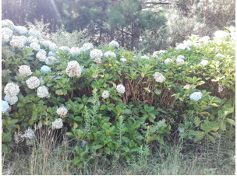
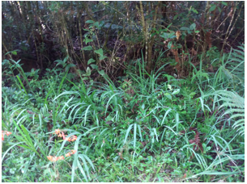
Data
Training set consisted of 2,295 labeled images with binary classifier
Test set was 1,531 unlabeled images
Each image had a resolution of 866x1154 pixels with a 256 bit RGB color vector

Slide 4
Approach
TensorFlow in Jupyter Notebook was used as the framework for all modeling.
Three model types were explored and tested for the binary image classification:
Logistic Regression (LR) and single-layer Neural Network (single-NN)
Linear Support Vector Machines (SVM)
Convolutional Neural Networks (CNN)
Model s were trained and tested on a high-performance AWS P2 GPU instance

Slide 5
Data Loading and Augmentation
A DataSet class was created at the start of this process to facilitate:
Lazy loading of images in different epochs. Lazy loading is important because of limited GPU/CPU memory resources.
Shuffling images for every new epoch to maximize training efficiency.
Augmentation of images (using imgaug library) through random blurring, flipping, rotation and other manipulations.

Slide 6
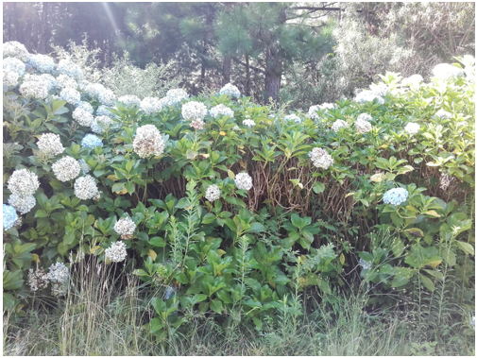
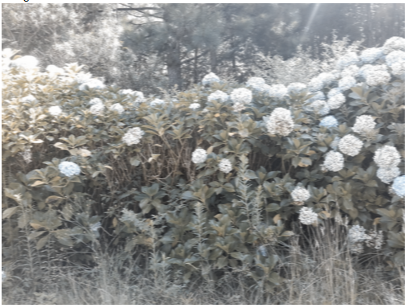
Image Augmentation
Normal Image
Augmented Image
Notes:
Augmented: Flip left-right + Gaussian Blur

Slide 7
Logistic Regression and Single - NN
Selected as a precursor to complex neural networks
Neural network analysis with no hidden layers:
Limited algorithm complexity leads to poor fit
Accuracy – 81% train, 71% test
Neural network analysis with 1 hidden fully connected layer layer:
Added complexity of a single layer improves ability to fit non-linear relationship
Accuracy – 100% train, 74% test

Slide 8
Support Vector Machines
Selection criteria:
Powerful algorithm for fitting non-linear data.
Linear SVM can handle large feature set with limited training data.
Results:
Accuracy with this approach was below the performance of the Logistic Regression model at 65%
Underfitting the data as feature set is too complex

Slide 9
Convolutional Neural Network
Selection Criteria:
CNN tailored for use with Image data
Less pre-processing needed compared to other image classification algorithms.
CNNs train and use filters to reduce dimensions of data while capturing variance.
Setup:
Input Layer
Convolution layer 1
Convolution layer 2
Max pool layer
Fully connected layer
Output layer
Notes:
Mention that Images resized because of memory constraints

Slide 10
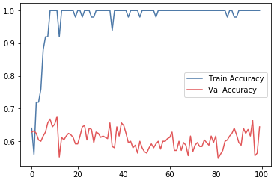
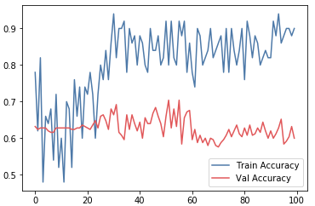
CNN - Results
Results:
Training on initial data set: Train Accuracy – 100%; Test Accuracy – 88%
Evidence of Overfitting
After applying Data Augmentation and increasing Dropout Rate: Train Accuracy – 100%; Test Accuracy – 92.5%
Notes:
Left – no data augmentation
Right – with data augmentation

Slide 11
Kaggle Competition Results
Global ranking based on performance on unseen images
Baseline Submission: Accuracy – 0.75753
Second Submission (after more training): Accuracy – 0.82862
Final Submission (Data Augmentation and Dropout): Accuracy – 0.83446
Final Rank: 224th

Slide 12
Next Steps
Use better hardware to handle complete images
Fine-tune CNN structure, layer composition, and hyper-parameters
Further augment data with image processing to create more samples
Use feature engineering to improve our feature set
Deploy non-linear SVMs, which are currently out of scope for TensorFlow

Slide 13
Thank you! Any Questions?

